Slide 1
Open Data Support Publishing of high value datasets: statistical data from Cyprus

Slide 2
This presentation has been created by PwC & TenForce Authors: Bert Van Nuffelen, Paul Massey - TenForce
Presentation metadata
Disclaimer
The views expressed in this presentation are purely those of the authors and may not, in any circumstances, be interpreted as stating an official position of the European Commission.
The European Commission does not guarantee the accuracy of the information included in this presentation, nor does it accept any responsibility for any use thereof.
Reference herein to any specific products, specifications, process, or service by trade name, trademark, manufacturer, or otherwise, does not necessarily constitute or imply its endorsement, recommendation, or favouring by the European Commission.
All care has been taken by the author to ensure that s/he has obtained, where necessary, permission to use any parts of manuscripts including illustrations, maps, and graphs, on which intellectual property rights already exist from the titular holder(s) of such rights or from her/his or their legal representative.
Open Data Support is funded by the European Commission under SMART 2012/0107 ‘Lot 2: Provision of services for the Publication, Access and Reuse of Open Public Data across the European Union, through existing open data portals’(Contract No. 30-CE-0530965/00-17).

Slide 3
Agenda
Welcome
DataCube Virtual Machine introduction
Vagrant introduction
Provided tooling & processes

Slide 4
Vagrant introduction

Slide 5
Setup the Vagrant environment
Vagrant is a method to create and configure lightweight, reproducible, and portable development environments.
Vagrant is a scripting deployment language, not virtualization software.
Therefore a provisioning software must be installed too. VirtualBox is default supported by Vagrant as provisioning software.
Download and deploy vagrant (http://www.vagrantup.com)
Download and deploy virtualbox (https://www.virtualbox.org/)

Slide 6
Vagrant machine description
To activate the desired virtual machine, a Vagrant machine description is required.
The DataCube Vagrant file is found at github https://github.com/paulmassey42/VagrantRDFCubes
Download and deploy git
(on windows git-bash is a good option - https://msysgit.github.io/)
Check out the vagrant machine description in a directory <DC>
git clone https://github.com/paulmassey42/VagrantRDFCubes.git

Slide 7
Vagrant machine activation
Open command shell
Execute shell commands
vagrant plugin install vagrant-vbguest
vagrant up
vagrant halt
vagrant up
Virtual machine will be created, provisioned and activated
Login: vagrant/vagrant
The data is available in the /vagrant directory

Slide 8
Vagrant machine activation – tips (1)
Make sure that Vagrant, VirtualBox, git are in the path.
(on windows)
echo $env:Path
C:\Program Files (x86)\Intel\iCLS Client\;C:\Program Files\Intel\iCLSclient\;C:\ProgramData\Oracle\Java\javapath;C:\Windows\system32;C:\Windows;C:\Windows\System32\Wbem;C:\Windows\System32\WindowsPowerShell\v1.0\;C:\Program Files\Intel\Intel(R) Management Engine Components\DAL;C:\Program Files\Intel\Intel(R) Management Engine Components\IPT;C:\Program Files (x86)\Intel\Intel(R) Management Engine Components\DAL;C:\Program Files (x86)\Intel\Intel(R) Management Engine Components\IPT;C:\Program Files\Intel\WiFi\bin\;C:\Program Files\Common Files\Intel\WirelessCommon\;C:\Users\bert.van.nuffelen\Vagrant\bin;C:\Program Files\TortoiseGit\bin;C:\Program Files (x86)\Git\cmd
Set PATH=%PATH%;C:\Users…

Slide 9
Vagrant machine activation – tips (2)
Make sure there is network connection.
On startup the vagrant execution will ask via which network adaptor network connectivity is created.
This is a manual choice.

Slide 10
Vagrant machine activation – tips (3)
After creation of the virtual machine, the machine can be activated via the VirtualBox environment or controlled from the command line via vagrant halt/down.

Slide 11
DataCube
virtual machine

Slide 12
DataCubes virtual machine
Intended as demonstration virtual machine
development requires additional steps
Contains data conversion pipeline in the directory OpenData
directory “cyprus” contains the data that has been used for the setup
a single sub-directory for each of the excel files processed,
each sheet of the excel file is processed separately as a CSV
naming convention was needed.
During VM provisioning
bootstrap.sh is executed which will run automatically,
Conversion scripts for descriptions found in OpenData

Slide 13
Rebuilding the Cubes
Rebuilding the cubes in existing VM
start a shell/terminal in the VM
same command in vagrant bootstrap.sh
( cd /vagrant_opendata ; make -k all )
This will rebuild all the known cubes
Adding new cubes, will need to load the generated RDF file
This isn’t automated (yet)

Slide 14
DataCubes virtual machine
Contains the LOD2 statistical office workbench (http://wiki.lod2.eu/display/LOD2DOC/LOD2+Statistical+Workbench) from the Linked Data Stack (http://stack.linkeddata.org)
Offers validation & visualisation possibilities of the generated RDF Data Cubes

Slide 15
Demo & walk through the Virtual Machine

Slide 16
Creation process of statistical data as RDF DataCubes

Slide 17
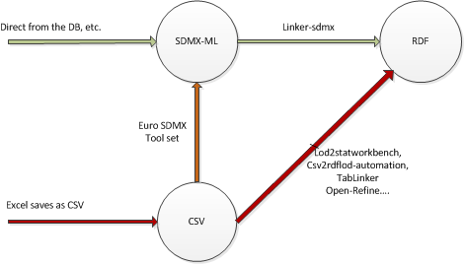
Publishing Statistical Data
Governmental statistical data is published on National portals
Some of those statistics are submitted to Eurostat

Slide 18
Publishing Statistical Data as Linked Data
Conversion to Linked Data according to the Data Cube Vocabulary

Slide 19
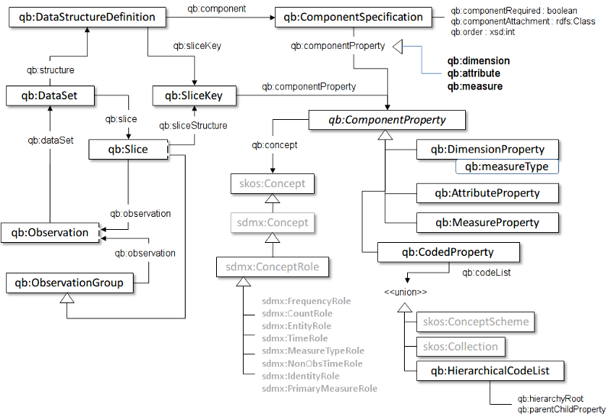
Data Cube Vocabulary http://www.w3.org/TR/vocab-data-cube/

Slide 20
Conversion process encounters data challenges
Time and the recognition/normalisation of the provided values,
Numerical value formats, units and types,
Titles and the CSV values identifying the DataCube dimensions,
Identifying if the data source has any legal requirements or other legal references which can be potentially used to create a relationships to other data sources,
Keywords, Themes, etc. which, if possible, should be mapped to common vocabularies increasing the linkage to other data sources.

Slide 21
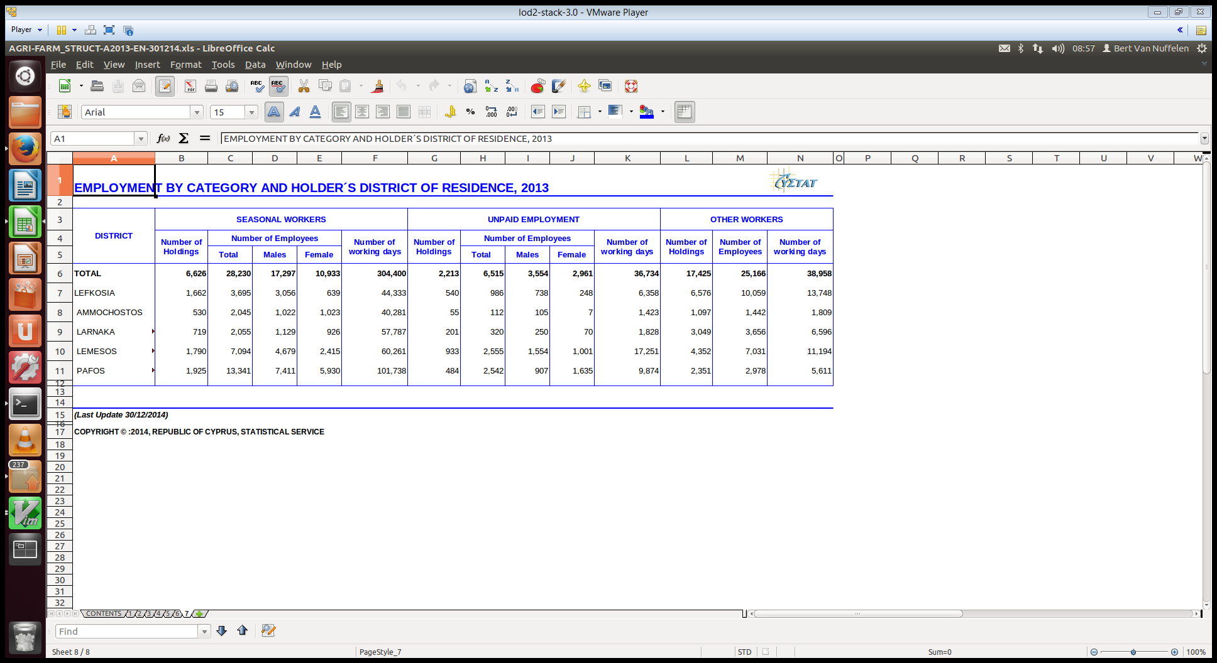
Example – Original Content

Slide 22
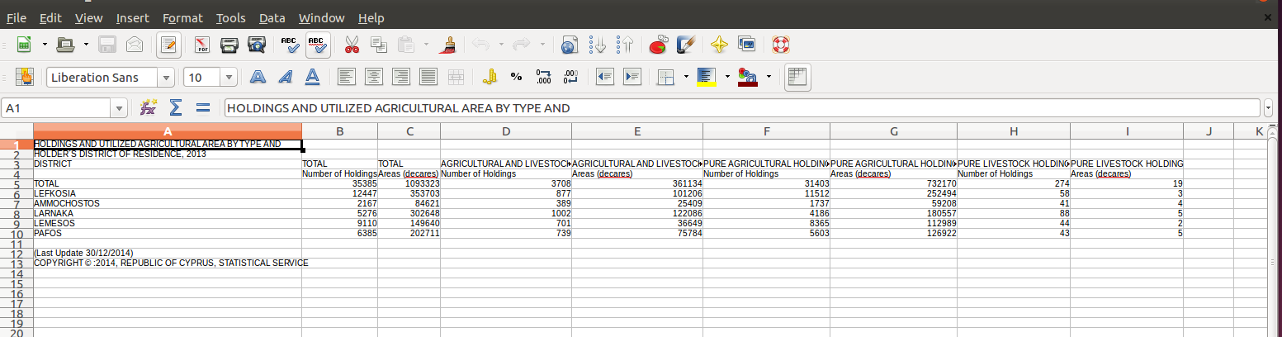
Example – Selected Sheet to CSV
Formatting work towards machine processeable information:
Only ‘data’ remains
Labels are repeated, etc.

Slide 23
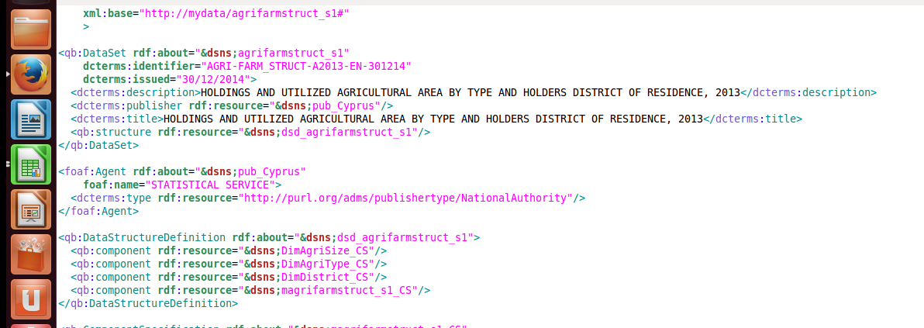
Example - RDF representation DataCube Dataset Structure

Slide 24

Example RDF representation DataCube Component Specifications

Slide 25
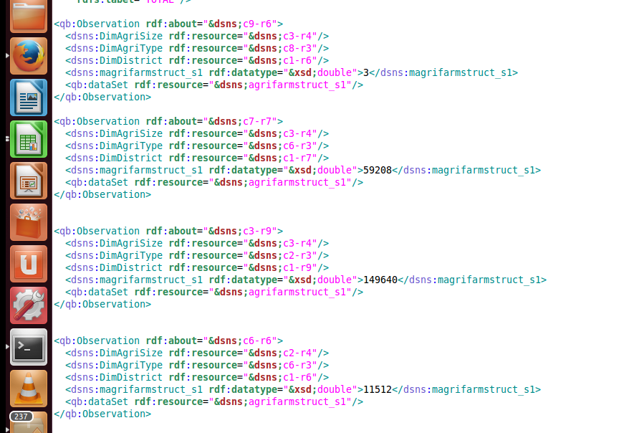
Example RDF representation DataCube Observations

Slide 26
Creation of dataset meta data descriptions according to DCAT-AP

Slide 27
The DCAT Application Profile data model

Slide 28
Controlled vocabularies
Property URI | Used for Class | Proposed vocabulary
dcat:mediaType | Distribution | MDR File types Name Authority List
dcat:theme | Dataset | EuroVoc domains
dcat:themeTaxonomy | Catalog | EuroVoc
dct:accrualPeriodicity | Dataset | Dublin Core Collection Description Frequency Vocabulary
dct:format | Distribution | MDR File Type Named Authority List
dct:language | Catalog, Dataset | MDR Languages Named Authority List
dct:publisher | Catalog, Dataset | MDR Corporate bodies Named Authority List
dct:spatial | Catalog, Dataset | MDR Countries Named Authority List, MDR Places Named Authority List
adms:status | CatalogRecord | ADMS change type vocabulary
dct:type | License Document | ADMS license type vocabulary

Slide 29
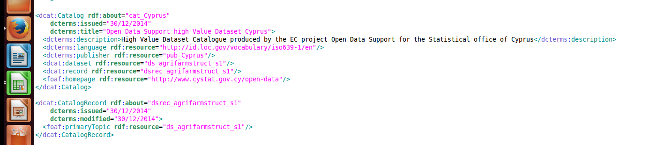
DCAT-AP description of the datasets Catalog

Slide 30
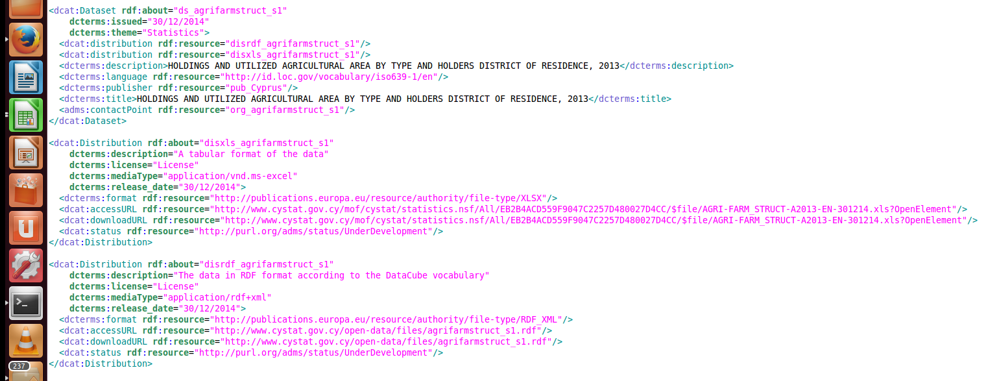
DCAT-AP description of the datasets Dataset & Distributions
Same identifier as in the generated DataCube RDF

Slide 31
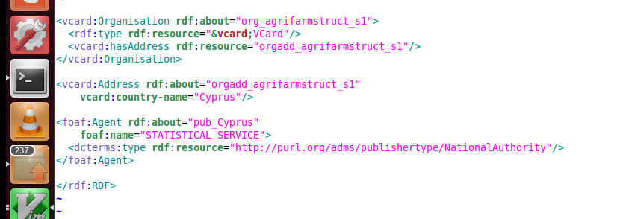
DCAT-AP description of the datasets publisher information

Slide 32





Be part of our team...
Find us on
Join us on
Open Data Support
http://www.slideshare.net/OpenDataSupport
Open Data Support
http://goo.gl/y9ZZI
http://www.opendatasupport.eu
Follow us
Contact us
@OpenDataSupport
contact@opendatasupport.eu

Slide 33


